Slide 1
Find out the pixels required to draw a circle with radius of 15 and centered at (30, 20)

Slide 2
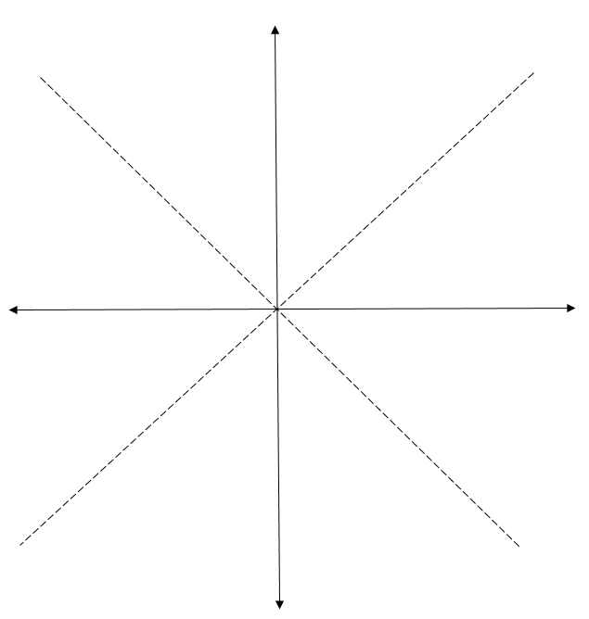
(30,35)
(x+30,y+20)
(30,20)
(0,15)
(x,y)
(0,0)

Slide 3
Circle with center at(0, 0) |  | Circle with center at(30, 20)
x | y | x+30 | y+20
0 | 15 | 30 | 35
1 | 15 | 31 | 35
2 | 15 | 32 | 35
3 | 15 | 33 | 35
4 | 14 | 34 | 34
5 | 14 | 35 | 34
6 | 14 | 36 | 34
7 | 13 | 37 | 33
8 | 13 | 38 | 33
9 | 12 | 39 | 32
10 | 11 | 40 | 31

